Slide 1
Forest Clearing and Regional Landscape
By: Montgomery, Schmidt, Greenburg, Dietrich
Summary by: Hunter Collins
ES 407
Dr. Taylor

Slide 2
Overview
Introduction
Background
Data
Interpretation
Conclusion

Slide 3
Introduction
Association between forest cutting and landslides has been known for centuries
Authors argue that the research so far is not an accurate representation of the true effects of timber harvest
Only have been recording big landslides and ignoring small scale slides
It is not necessarily the fault of previous researchers

Slide 4
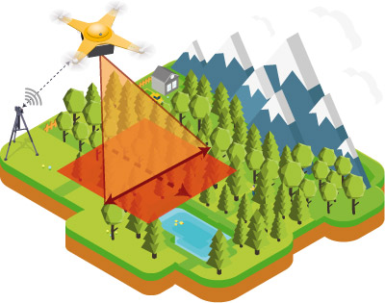
So why is previous data “unreliable”?
Forest canopy makes it difficult to detect small scale landslides
Due to this there is a bias in the data of aerial photo inventories
Storms also are variable and introduce a major discrepancy in studies and comparisons
Most studies which had been conducted at this time covered single watersheds and not a larger area, creating a narrow scope for applicability

Slide 5
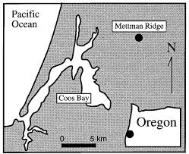
Background
Study conducted at Mettman Ridge near Coos Bay, Oregon
Area= 0.43km^2
Area had burned down in late 19th century
Clear cut in ‘87 and replanted ‘88
This time frame allows for a 10 yr study
Geologically area lays on Eocene sandstone topped by colluvial soils that are close to cohesionless
Most of net soil cohesion for the area comes from root strength
Very steep terrain, made it a great area of study for “maximum impact” estimate

Slide 6
Methods
After the clear cutting and replanting of the region researchers went through forest and counted up the landslides they could identify in 1989
Then continued to walk through each year to reexamine the area for new scars
Used digital terrain modeling with high resolution laser altimetry
Coarser Resolution regional study of 3224 landslides
Regional study allows for a “minimum impact” estimate as this is what has been observed by other researchers over the years

Slide 7
Data
Walked through in 1989 and identified sixteen landslides which occurred since clear cutting in 1987
Yearly walkthroughs were conducted to reexamine the land for new landslide scars
35 total landslides recorded between 1987 and 1996
10 of these were associated with a ridgetop road
Year | Landslides
1990 | 5
1991 | 3
1992 | 5
1993 | 1
1996 | 5

Slide 8
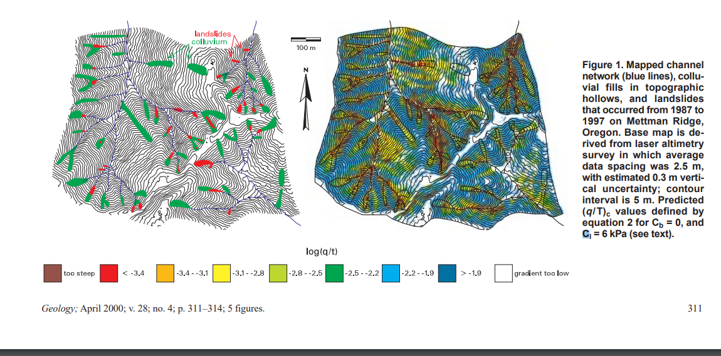

Slide 9
Shallow Landslides/More data
Landslides in this study extended to the soil bedrock interface
Normally shallow soil landslides occur during intense/long duration storms
Most landslides had a three to five year recurrence interval
Nearly half of the observed landslides occured during storms with less than 4 year recurrence interval
Erosion rate of the area comes out to 2400 tons per km^2 per year
Leads to a net lowering rate of 2.0 mm per year

Slide 10
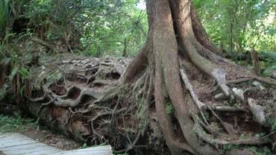
How trees help
Mature conifers have a cohesion attribute of >10kPa
Cut stumps only have 2-4 kPa
4-6 kPa on the high end
This leads to a much lower soil cohesion in an area of regrowth
Due to stumps rather than trees in area more landslides occurred
Lateral root strength amongst trees is important as roots do not penetrate into the bedrock
Historical Hollow failure rate only 0.01-0.03 landslides per km^2 per year
2 orders of magnitude less than observed at the ridge

Slide 11
Interpretations
Research showed that small landslides triggered through common storms were normal in frequency but often overlooked by most data due to being hard to spot
These small landslides can lead to dramatic increase in sediment yield
Study showed that common storms can trigger shallow landslides in the steep terrain
Especially in decade following clear cutting
Landsliding occurs more widely across landscape with low apparent cohesion

Slide 12
Conclusion
Overall this study showed that there was a greater relationship between clear cutting/timber harvest practices and land stability
Through the combination of laser imaging, regional study, and first hand walkthrough and observation
Due to clear cutting shallow landslides, normally triggered during intense storms, were occuring often during common storms
Overall less soil stability and cohesion due to root loss leads to many of these landslides being more possible

